Slide 1


G H Raisoni College of Engineering and Management, Pune (An Autonomous Institute Affiliated to SPPU)
TAE Assessment Sheet for FY B Tech
SR.NO | ROLL NO |  | DIVISION |  | NAME OF THE STUDENT |  |  | TAE NO | POSTER/PRESENTATION
1 | A69 |  | A |  | Soham Yugraj Tiwari |  |  | 2 | Presentation
2 | A70 |  | A |  | Amaan Ayyub Nalband
3 | A71 |  | A |  | Shravan Vijaypratap Singh
4 | A72 |  | A |  | Pratik Rajesh Jade
Rubrics For Assessment
CATEGORY |  | Contents |  | Presentation |  | Spelling and pronunciation | Oral Presentation |  | TOTAL
Maximum MARKS |  | 2 |  | 1 |  | 1 | 1 |  | 5
Marks obtained
 |  |  |  |  |  | Teacher sign (With name and date)

Slide 2
G H Raisoni College of Engineering and Management, Pune
Transmission Electron Microscopy (TEM)

Slide 3
G H Raisoni College of Engineering and Management, Pune
Contents
Introduction And Definition.
Theoretical Background.
Difference between light microscope and electron microscope.
Construction.
Design of Transmission Electron.
TEM Sample Preparation.
What Information can TEM Provide..?
Limitations of TEM.

Slide 4
G H Raisoni College of Engineering and Management, Pune
Introduction
Microscopes are used to see objects that cannot be seen by naked eyes.
The range can be between mm to nm.
There are three main microscopic techniques.
I. Optical Microscopy
II. Scanning Probe Microscopy
III. Electron Microscopy.

Slide 5
G H Raisoni College of Engineering and Management, Pune
Transmission Electron Microscopy (TEM)
Transmission electron microscopy (TEM) is a microscopy technique where a beam of electrons is transmitted through a ultra thin specimen. An image is formed from the interaction of the electrons transmitted through the specimen; the image is magnified and focused onto an imaging device, such as a fluorescent screen, on a layer of photographic film, or to be detected by a sensor such as a CCD camera.

Slide 6
G H Raisoni College of Engineering and Management, Pune
Theoretical Background
Why we need Electron Microscope?
Light microscopes are limited by the physics of light to 500x or 1000x magnification and a resolution of 0.2 micrometers.
In the early 1930's there was a scientific desire to see the fine details of the interior structures of organic cells (nucleus, mitochondria...etc.).
This required 10,000x plus magnification which was just not possible using Light Microscopes.

Slide 7
G H Raisoni College of Engineering and Management, Pune
Difference between light microscope and electron microscope
FEATURES | LIGHT MICROSCOPE | ELECTRON MICROSCOPE
Electromagnetic spectrum used | Visible light 760nm (red) – 390 nm Colours visible | Electrons app. 4nm Monochrome
Maximum resolving power | approx. 200 nm | 0.2nm
Maximum magnification | x1000 – x1500 | x500000
Radiation source | Tungsten or quartz halogen lamp | High voltage (50kV) tungsten lamp
Lenses | Glass | Magnets
Interior | Air Filled | Vacuum
Focusing screen | Human eye (retina), photographic film | fluorescent (TV) screen, photographic film

Slide 8
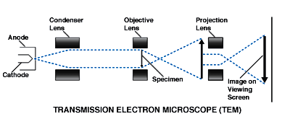
G H Raisoni College of Engineering and Management, Pune
Construction
In a conventional transmission electron microscope, a thin specimen is irradiated with an electron beam of uniform current density.
Electrons illuminate the specimen through a condenser lens system.
Objective lens provides the formation of either image or diffraction pattern of the specimen.
The electron intensity distribution is magnified with a lens system and viewed on a fluorescent screen. The image can be recorded by an image plate or digitally by a CCD camera.

Slide 9
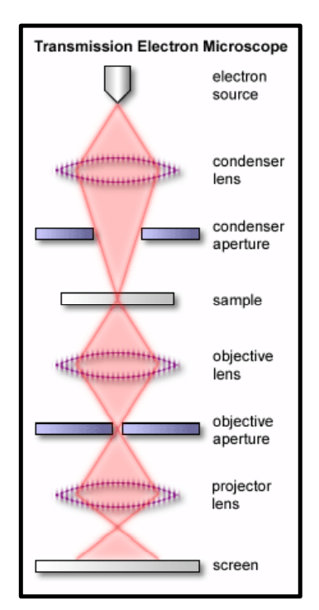
G H Raisoni College of Engineering and Management, Pune
Design of Transmission Electron Microscope
A simplified ray diagram of a TEM consists of an electron source, condenser lens with aperture, specimen, objective lens with aperture, projector lens and fluorescent screen.

Slide 10
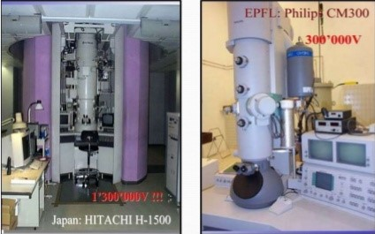
G H Raisoni College of Engineering and Management, Pune
Some of the Typical TEM models

Slide 11
G H Raisoni College of Engineering and Management, Pune
TEM Sample Preparation
The TEM sample should be thin, so special care must be taken while cutting a thin slice so that the specimen is not deformed during its preparation. Some common techniques are:-
SPARK CUTTER: - In this, electric discharge between a wire and the specimen is used to cut the metal by removing small particles of metal from the surface of the specimen.
FOCUSED ION BEAM (FIB):- A thin slice of the sample is cut by an ion beam on a scanning ion microscope. The main advantage of this method is that it allows selective thinning at desired locations by cutting trenches in the sample.

Slide 12
G H Raisoni College of Engineering and Management, Pune
Some Basic Requirements
Cleaning the surface of the specimen.
The proper cleaning of the surface of the sample is important because the surface can contain a variety of unwanted deposits, such as dust, silt, media components or other contaminants.
The best way to clean the surface of specimen from contaminants is to carefully rinse them three times for 10 min in 0.1M cacodylic acid buffer (pH 7.3) at room temperature.

Slide 13
G H Raisoni College of Engineering and Management, Pune
What Information Can TEM Provide?
Thickness of the specimen: The transmission of unscattered electrons is inversely proportional to the specimen thickness.
Orientation, atomic arrangements and phases present:
Given by incident electrons that are scattered by specimen atoms in an elastic fashion. These electrons follow Bragg's Law
nλ=2dSinθ .
The incident electrons that are scattered by the same atomic spacing will be scattered by the same angle. These scattered electrons can be collated using magnetic lenses to form a pattern of spots; each spot corresponding to a specific atomic spacing (a plane).

Slide 14
G H Raisoni College of Engineering and Management, Pune
Inelastically scattered electrons can be utilized in two ways: Electron Energy Loss Spectroscopy (EELS) and Kikuchi Bands.
Elemental composition and atomic bonding state:
Determined by analyzing the energy with spectroscope attached under the electron microscope (Electron Energy Loss Spectroscopy). By selecting electrons with a specific loss energy, element distribution in specimen can be visualized.

Slide 15
G H Raisoni College of Engineering and Management, Pune
What Information Can TEM Provide?
Incident electron beam
REACTIONS ON THE BOTTOM SIDE ARE EXAMINED IN THIN OR FOIL SPECIMEN (TEM)
Interaction volume
Sample
Fall (TEM)
Elastically scattered electron
Elastically scattered electron
Unscattered e-
Transmitted Electron

Slide 16
G H Raisoni College of Engineering and Management, Pune
Limitations of TEM
Sampling: Very small sample size. But fortunately we are dealing with nanostructures.
Interpreting transmission images: TEM presents 2D images of 3D specimens.
Electron Beam damage and Safety: TEM is a potential dangerous instrument that generates radiation level that is enough to kill human being.
Specimen preparation: Your specimens have to be thin, very thin (has to be electron transparent) if you are going to get any information.

Slide 17
G H Raisoni College of Engineering and Management, Pune
Thank You

